Slide 1
(IGTS) Temporal Segmentation for multivariate time series
Amin Sadri
Flora Salim
Yongli Ren

Slide 2

Detecting Transition Times (Temporal aspects)
What is an appropriate way to extract transition times?
Home
University
Restaurant
University
Home
9am
1pm
2pm
6pm
Notes:
Since outlier analysis is a popular data mining task, a powerful outlier detection algorithm for mobility pattern is needed urgently. No tools are publicly available to calculate user similarity with mobility patterns.

Slide 3
Applications
Recommendation systems
Pre-processing stage
Prediction in each segment
Anomaly detection in each segment
High-level activity detection in each segment
Home
University
Restaurant
University
Home
9am
1pm
2pm
6pm
Notes:
Since outlier analysis is a popular data mining task, a powerful outlier detection algorithm for mobility pattern is needed urgently. No tools are publicly available to calculate user similarity with mobility patterns.

Slide 4
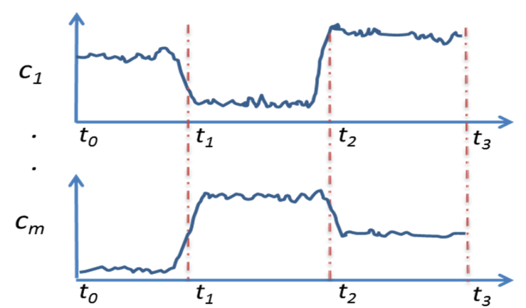
Problem and Solution
Our Problem: Given the time series data from multiple channels for a user, how to find the transition times in the daily activity.
New Temporal Segmentation method:
Temporal Segmentation: Factorizing time series into several temporally homogeneous segments
Notes:
Since outlier analysis is a popular data mining task, a powerful outlier detection algorithm for mobility pattern is needed urgently. No tools are publicly available to calculate user similarity with mobility patterns.

Slide 5
Challenges
Input time series: Sensor Data, Connectivity data, Smartphone logs
Multivariate
Heterogeneous
Mobility patterns are different for different users.
should be obtrusive otherwise requires time and energy
Data may come from a group of people
Generic
Unsupervised
Fast
Non-parametric
Temporal Segmentation Method
applicable to all types of time series regardless of correlation between them
otherwise requires time and energy

Slide 6
Literature Review Transition Times in Human Mobility
Some studies skip this step and fixed time slots.
probabilistic topic models : 0-7am, 7-9am, 9-11am, 11am-2pm, 2-5pm, 5-7pm, 7-9pm, and 9-12pm {Farrahi 2010}
Student life project:12am-9am, 9am-6pm, 6pm-11am {Wang 2014}
Prediction based on hidden Markov model {Mathew 2012}
Best segmentation among 11 predefined segmentation {Bao 2014}
Topic models such as Latent Dirichlet Allocation {Sun 2014}
Costly
Parametric
Matrix Profile {Keough 2016}
Single time series

Slide 7
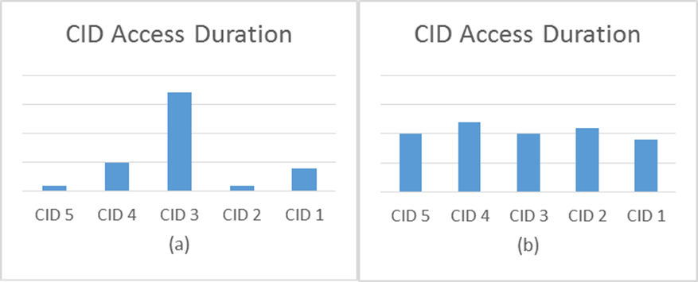

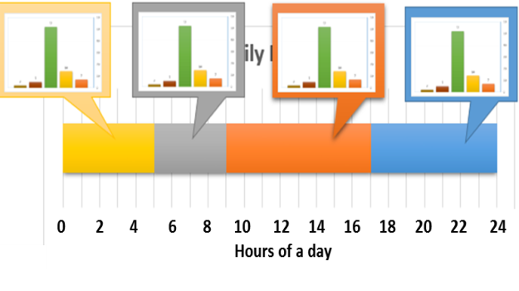
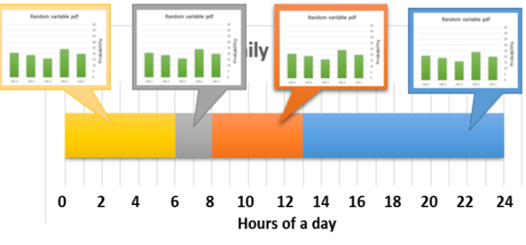


Temporal Segmentation based on Information Gain
Low-entropy pattern
High-entropy pattern
The proposed method try to capture the segments with the lowest entropy => the user location is predictable in each segment
The best segmentation is the one with the highest information gain.

Slide 8
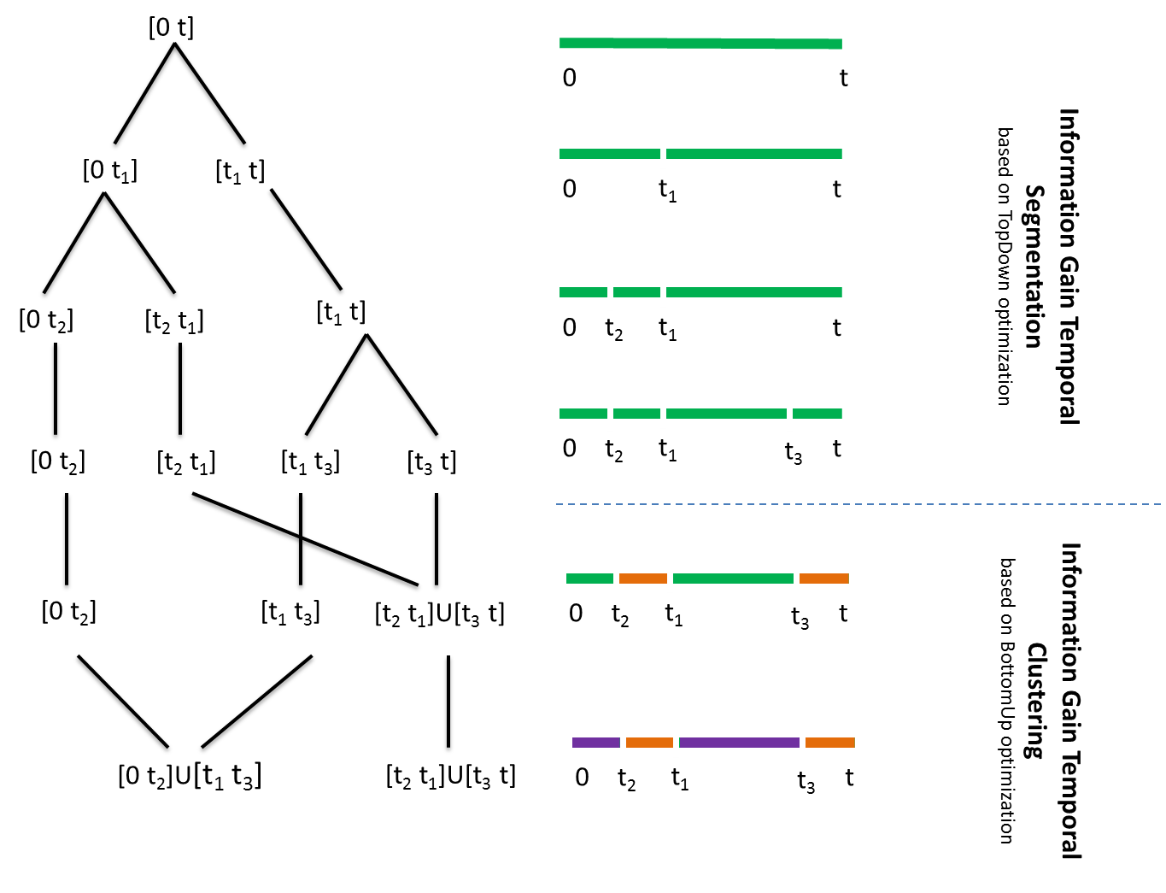
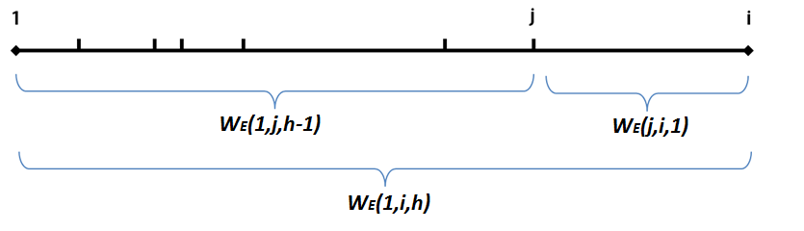
RQ1: Search Strategy
TopDown optimization method
Local optima
Dynamic programming
Global optima
More complex

Slide 9
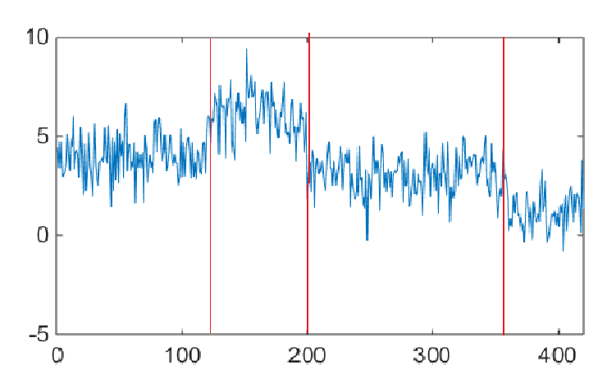
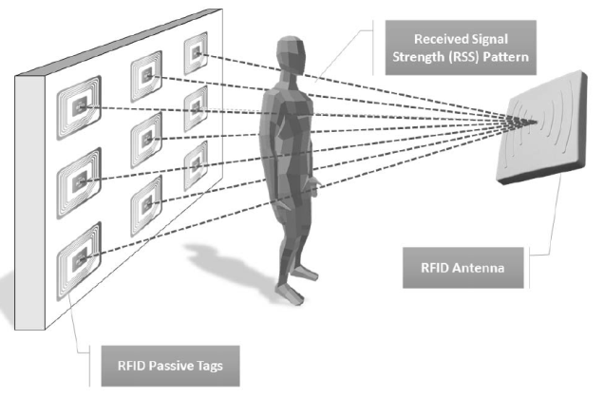
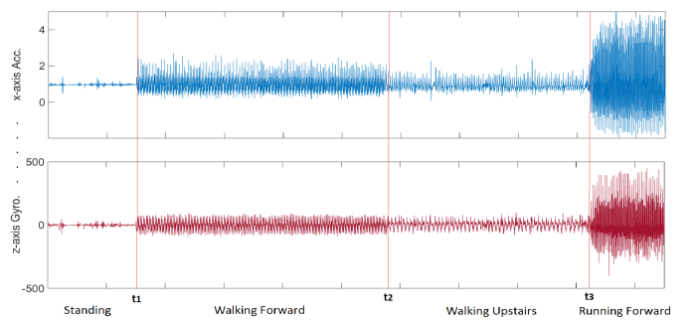
RQ1: Experiments on Different Datasets
Synthetic Dataset:
2-4 time series, Gaussian noise
Device free posture recognition by RFID
{Yao 2015} :
9 tags measuring RSSI
When the user changes his posture
USC Human Activity Dataset {Zhang 2012}:
x,y,z Gyroscope
x,y,z Accelerometer
When the user changes his activity ( from walking to standing)

Slide 10
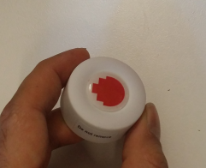
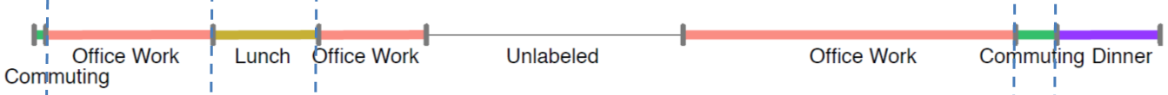
RQ1: Datasets- Cont.
Movement detection by Bluetooth iBeacons
Bluetooth RSSI from 4 iBeacons recorded by a smartphone
When the position of the smartphone is changed
Daily Life Routine Dataset {Huynh 2008} :
34 daily low-level activity labels
4 daily high-level activity labels
When the high-level or low-level activities are changes
Smartphone logs from Device Analyzer {Wagner 2014}:
Sensor data, wireless connectivity, GSM communication, system status

Slide 11
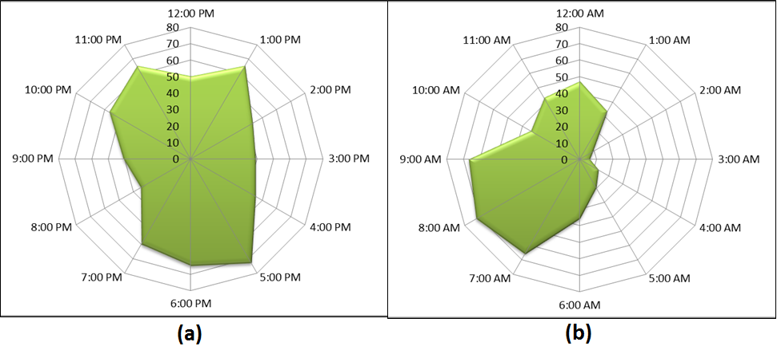
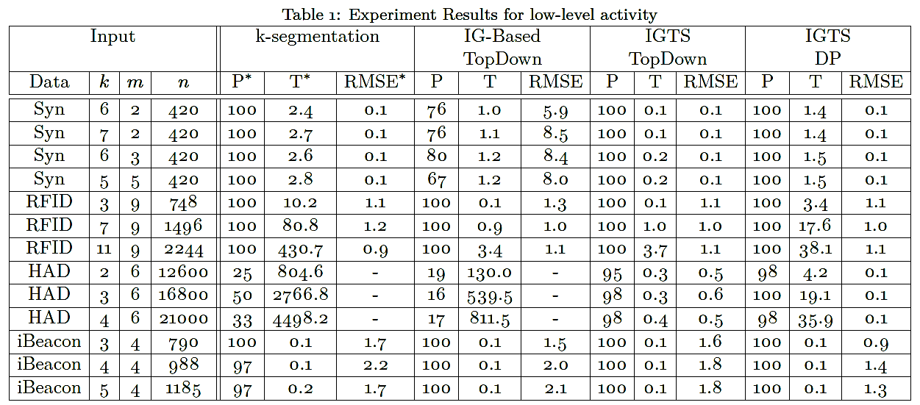
RQ1: Results –Transition Times

